Slide 1
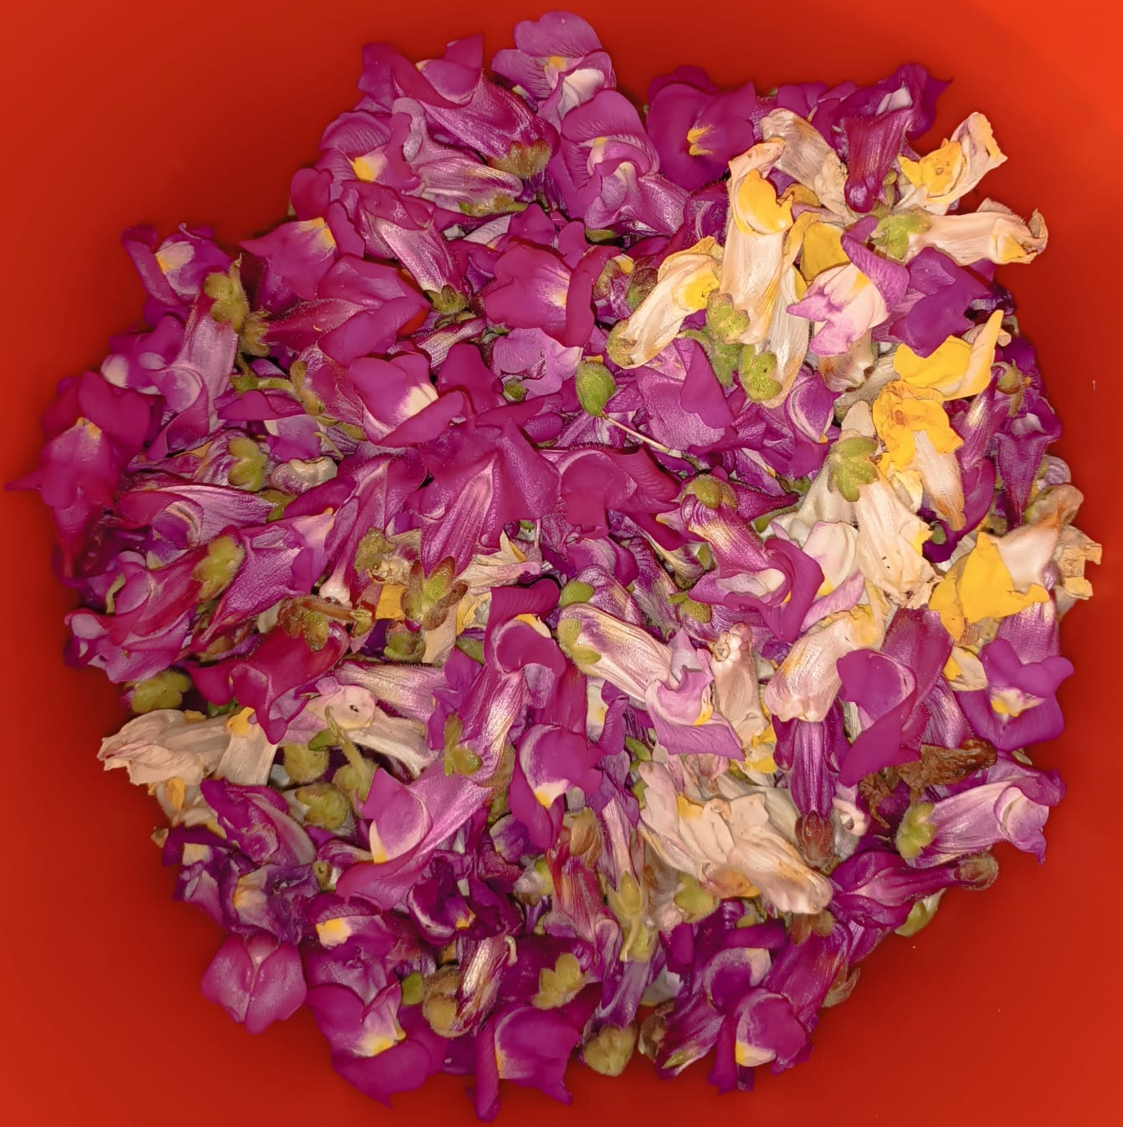
Genome wide association study: COLORS OF SNAPDRAGONS
Rotation 4: Barton Group
Maria Fernanda Adame Galeano

Slide 2
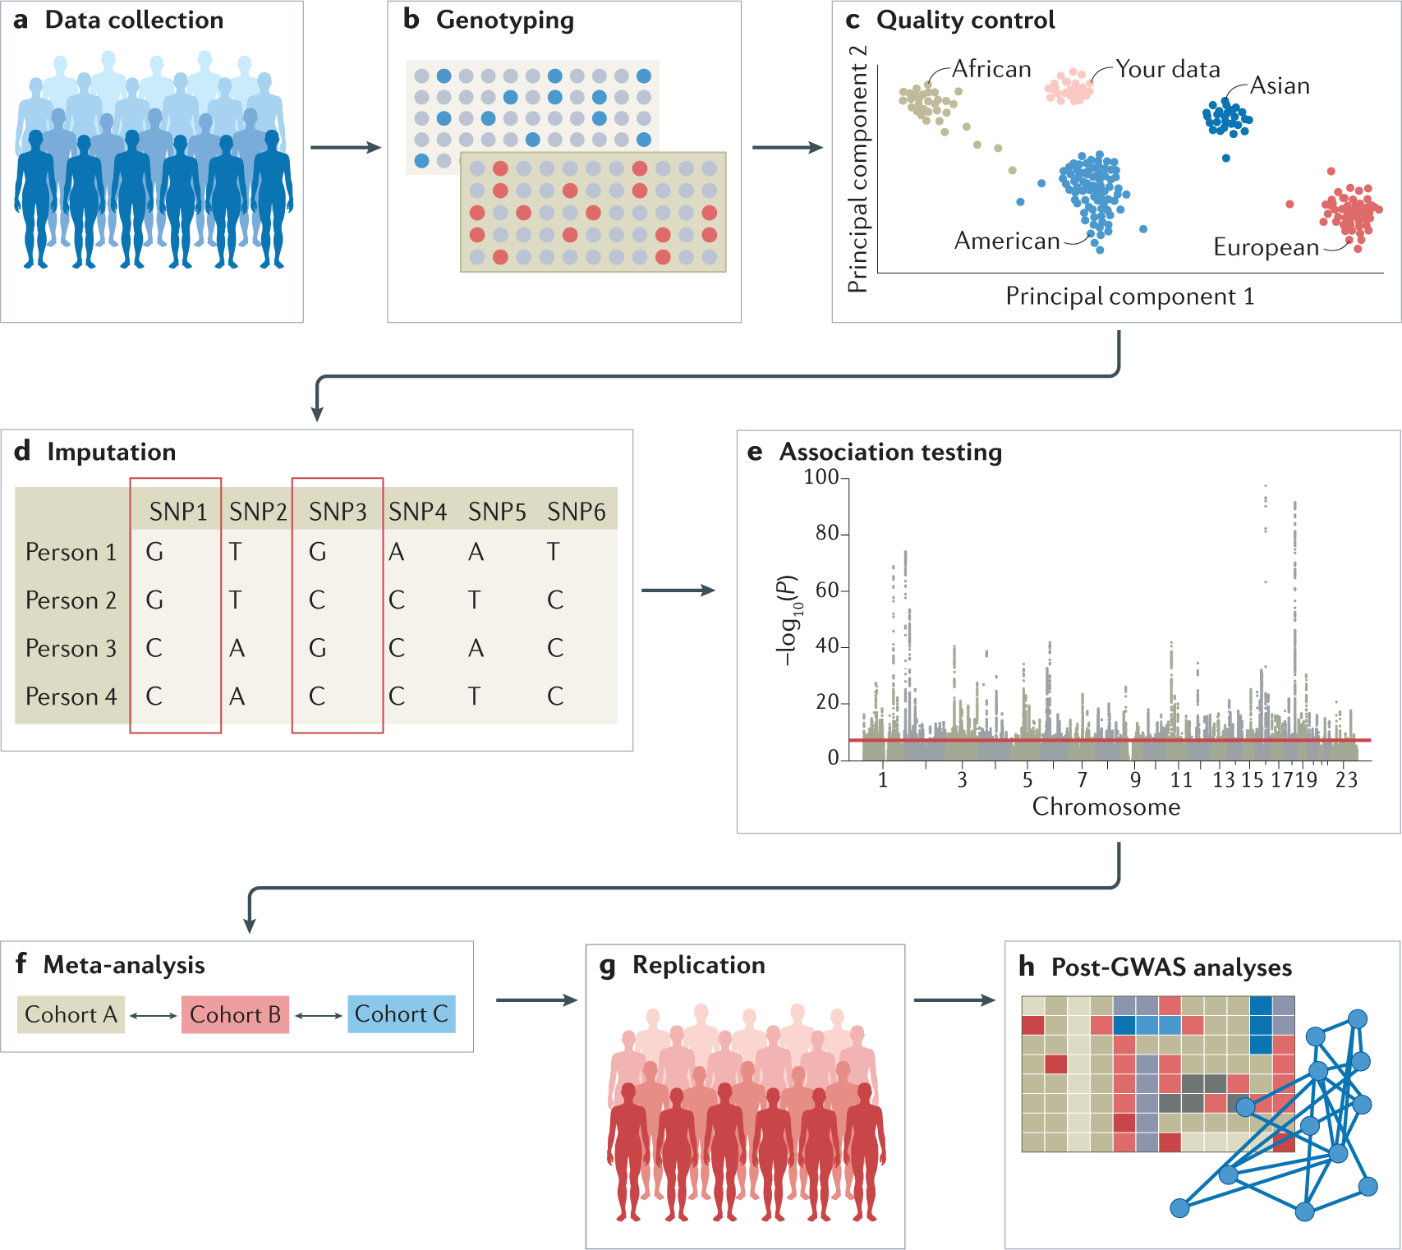
Gwas: Genome Wide Association study
Test hundreds of thousands of genetic variants across genomes from a population to find those statistically associated with a specific trait.
Uffelmann et al.

Slide 3
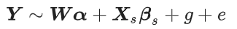
Linear regression models for GWAS:
Y is a vector of phenotype values
W is a matrix of covariates including an intercept term
α is a corresponding vector of effect sizes
X_{s} is a vector of genotype values for all individuals at SNP s
β_{s} is the corresponding fixed effect size of genetic variant s (also known as the SNP effect size)
g is effect that captures the polygenic effect of other SNPs
e is a random effect of residual errors

Slide 4
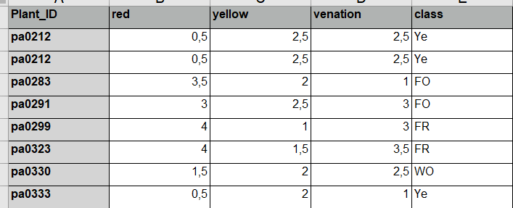
Data
Total no. plants: 1053
8 chromosomes
Number of NAN values:
red 91
yellow 91
venation 99
class 95
Total number of NAN values: 376
Total number of NAN rows: 103

Slide 5
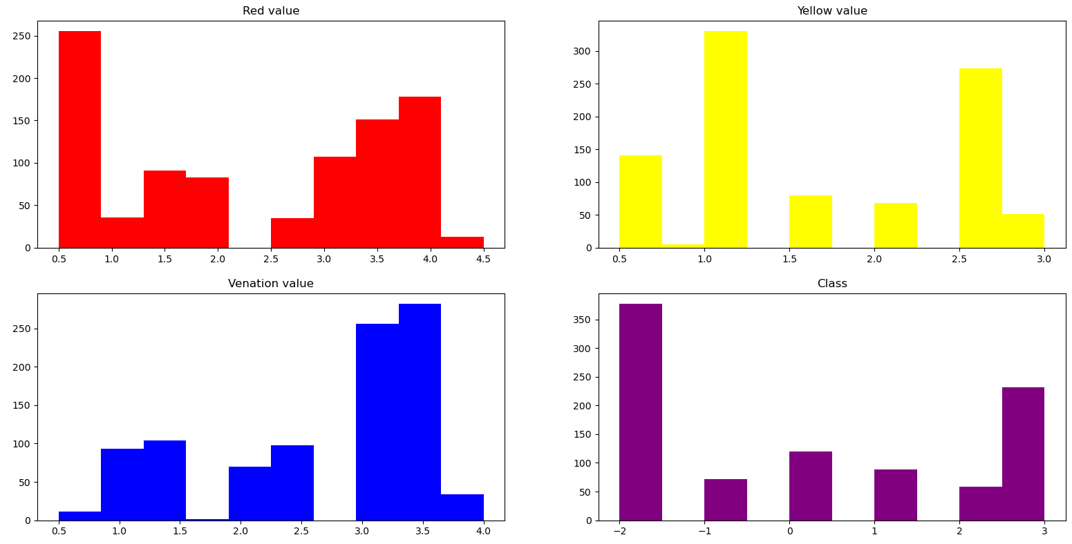
Histograms
Class code:
fr red -2
fo orange -1
wr white red 0
wo white orange 1
wh white 2
ye yellow 3

Slide 6
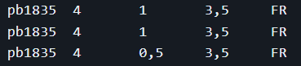
Cleaning data
Raw Data
Duplicated?
Duplicates:
All the same information then delete one entry
Otherwise use average values and NAN if the class is different
Yes
No
Average or delete entry
Filter plants
Consistent ID name
Add phenotype data
Total no. flowers without duplicates: 949
VCF genotype files
PLINK files

Slide 7
GEMMA: Genome-wide Efficient Mixed Model Association
Software toolkit for fast application of linear mixed models (LMMs) and related models to genome-wide association studies (GWAS) and other large-scale data sets.
Input files:
Genotypes
Phenotypes
Relatedness matrix
Covariates (optionally)
Genotype and phenotype files can be in two formats, either both in the PLINK binary ped format or both in the BIMBAM format.

Slide 8
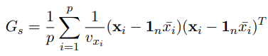
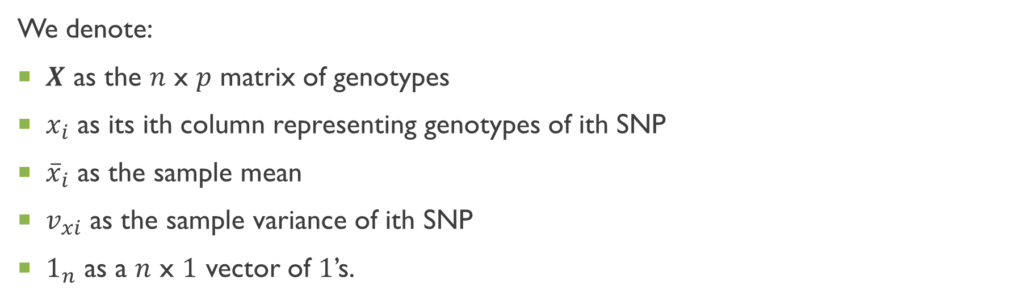
Relatedness matrix
We denote:
$X$ as the $n$ x $p$ matrix of genotypes
$x_{i}$ as its ith column representing genotypes of ith SNP
${\overline{x}}_{i}$ as the sample mean
$v_{xi}$ as the sample variance of ith SNP
$1_{n}$ as a $n$ x $1$ vector of $1$’s.

Slide 9
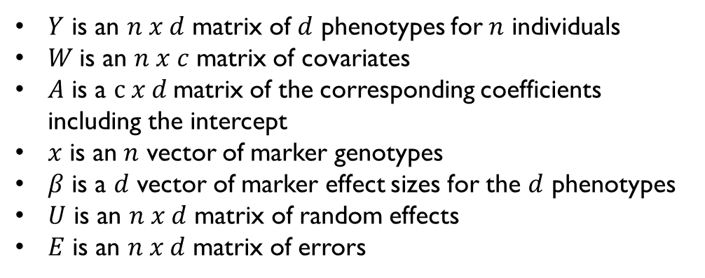
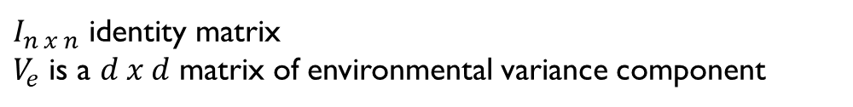
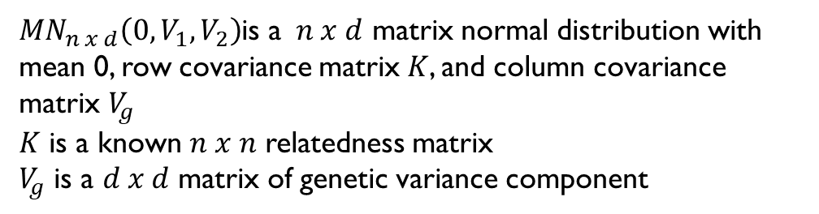
Multivariate Linear Mixed Model
$Y$ is an $n x d$ matrix of $d$ phenotypes for $n$ individuals
$W$is an $n x c$ matrix of covariates
$A$ is a $c x d$matrix of the corresponding coefficients including the intercept
$x$ is an$n$ vector of marker genotypes
$β$ is a $d$ vector of marker effect sizes for the $d$ phenotypes
$U$ is an $n x d$ matrix of random effects
$E$ is an $n x d$ matrix of errors
${MN}_{n x d}\left(0,V_{1},V_{2}\right)$is a $n x d$ matrix normal distribution with mean 0, row covariance matrix $K$, and column covariance matrix $V_{g}$
$K$ is a known $n x n$ relatedness matrix
$V_{g}$ is a $d x d$ matrix of genetic variance component
$I_{n x n}$ identity matrix
$V_{e}$ is a $d x d$ matrix of environmental variance component

Slide 10
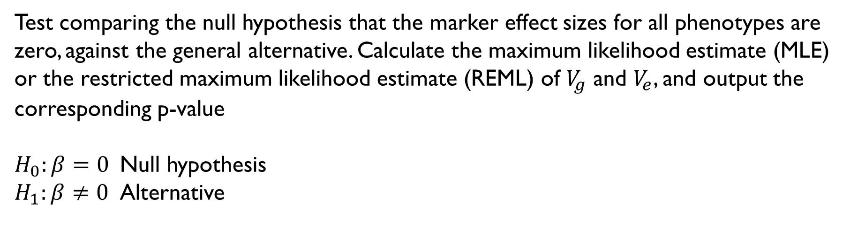
P-values
Test comparing the null hypothesis that the marker effect sizes for all phenotypes are zero, against the general alternative. Calculate the maximum likelihood estimate (MLE) or the restricted maximum likelihood estimate (REML) of $V_{g}$ and $V_{e}$, and output the corresponding p-value
$H_{0}:β=0$ Null hypothesis
$H_{1}:β≠0$ Alternative

Slide 11
Genes involved in color of snapdragons
Cremosa
Chr1:900000-1000000
Aurina?
Chr2:2025000-1100000
Flavia
Chr2:52650000-54050000
Sulfurea
Chr4:38050000-38425000
Rubia
Chr5: 6250000-6300000
Rosea + Eluta
Chr6:52500000-53500000

Slide 12
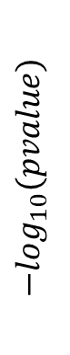
Results
SNP
chr1
chr2
chr3
Manhattan plots
p-value=5x10-8
$$−\log_{10}(pvalue)$$
…
Position

Slide 13
All individuals
Venation

Slide 14
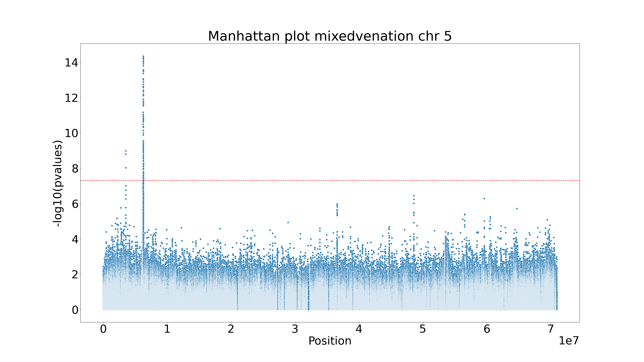

Slide 15
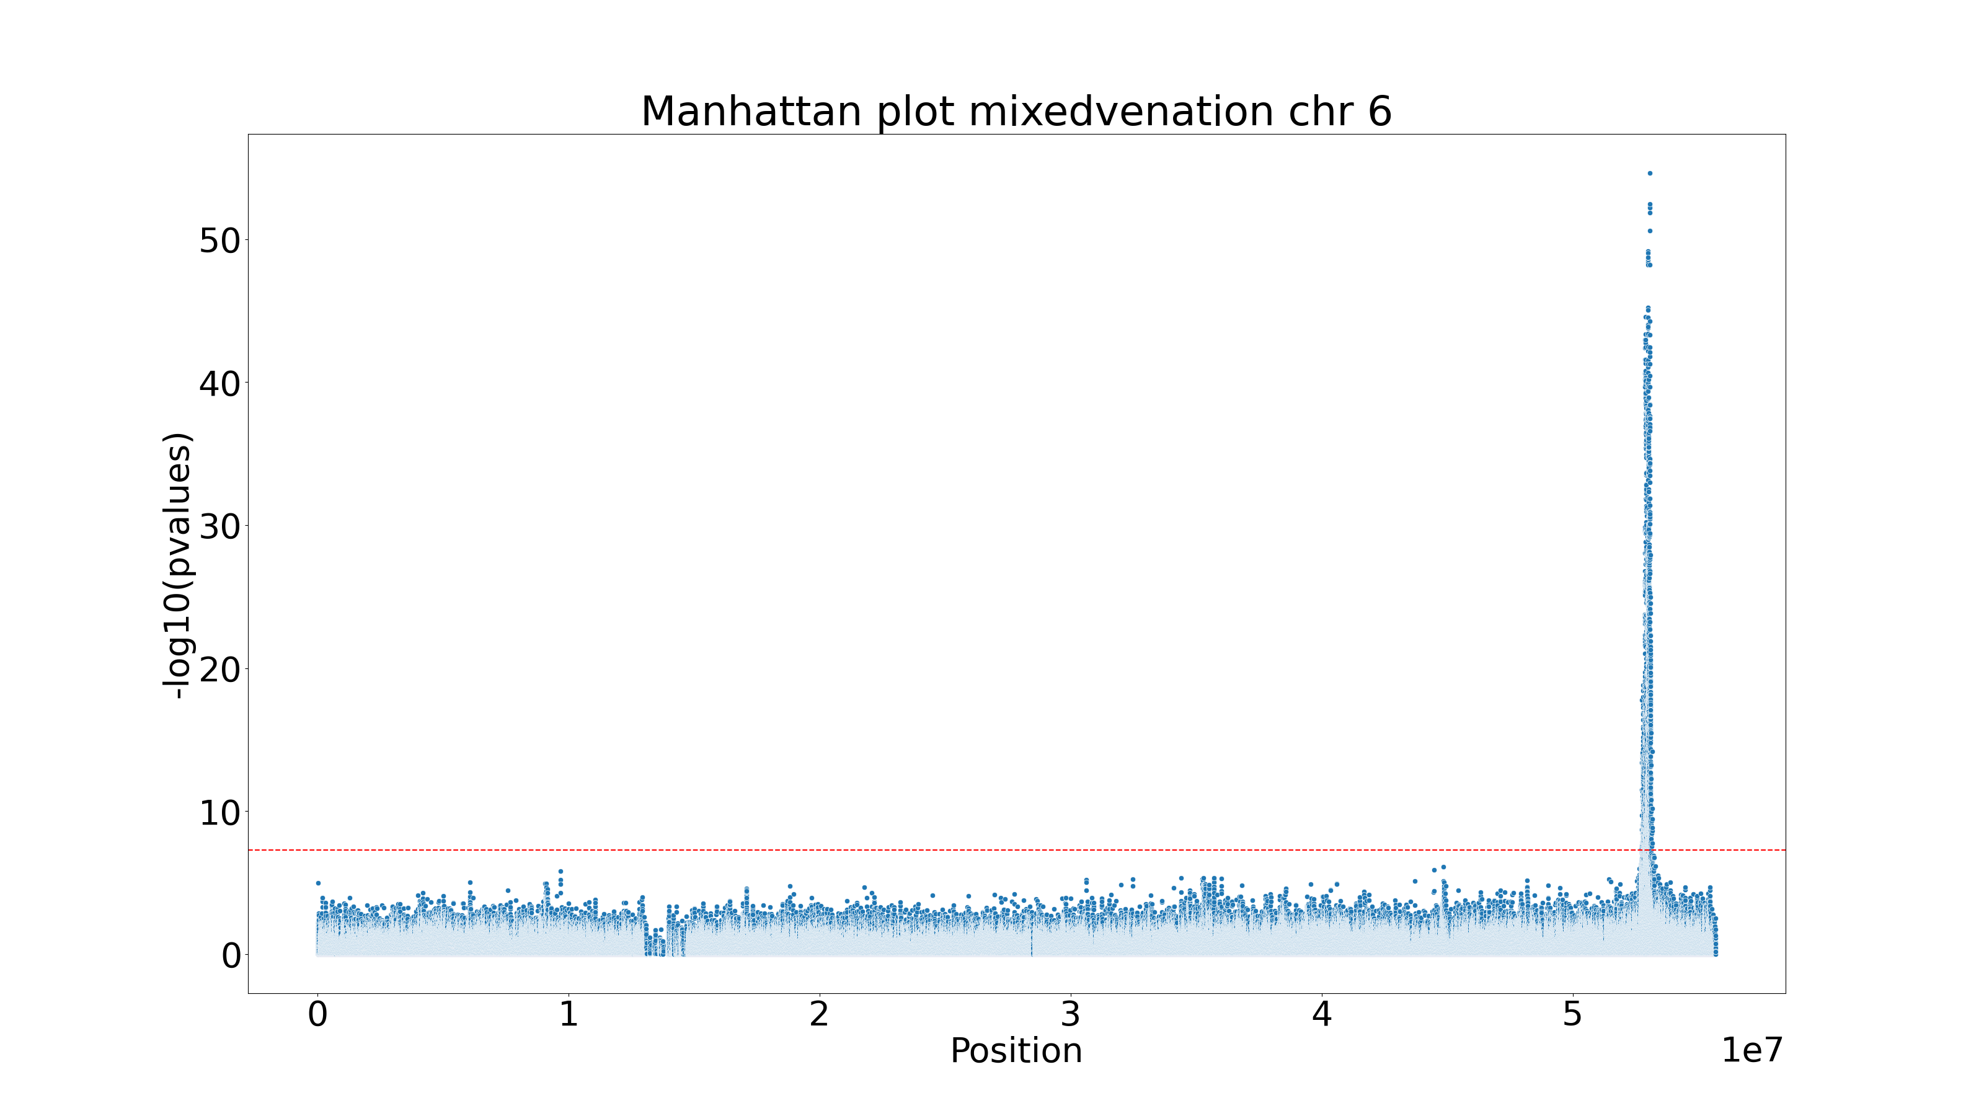

Slide 16
All individuals
Yellow

Slide 17
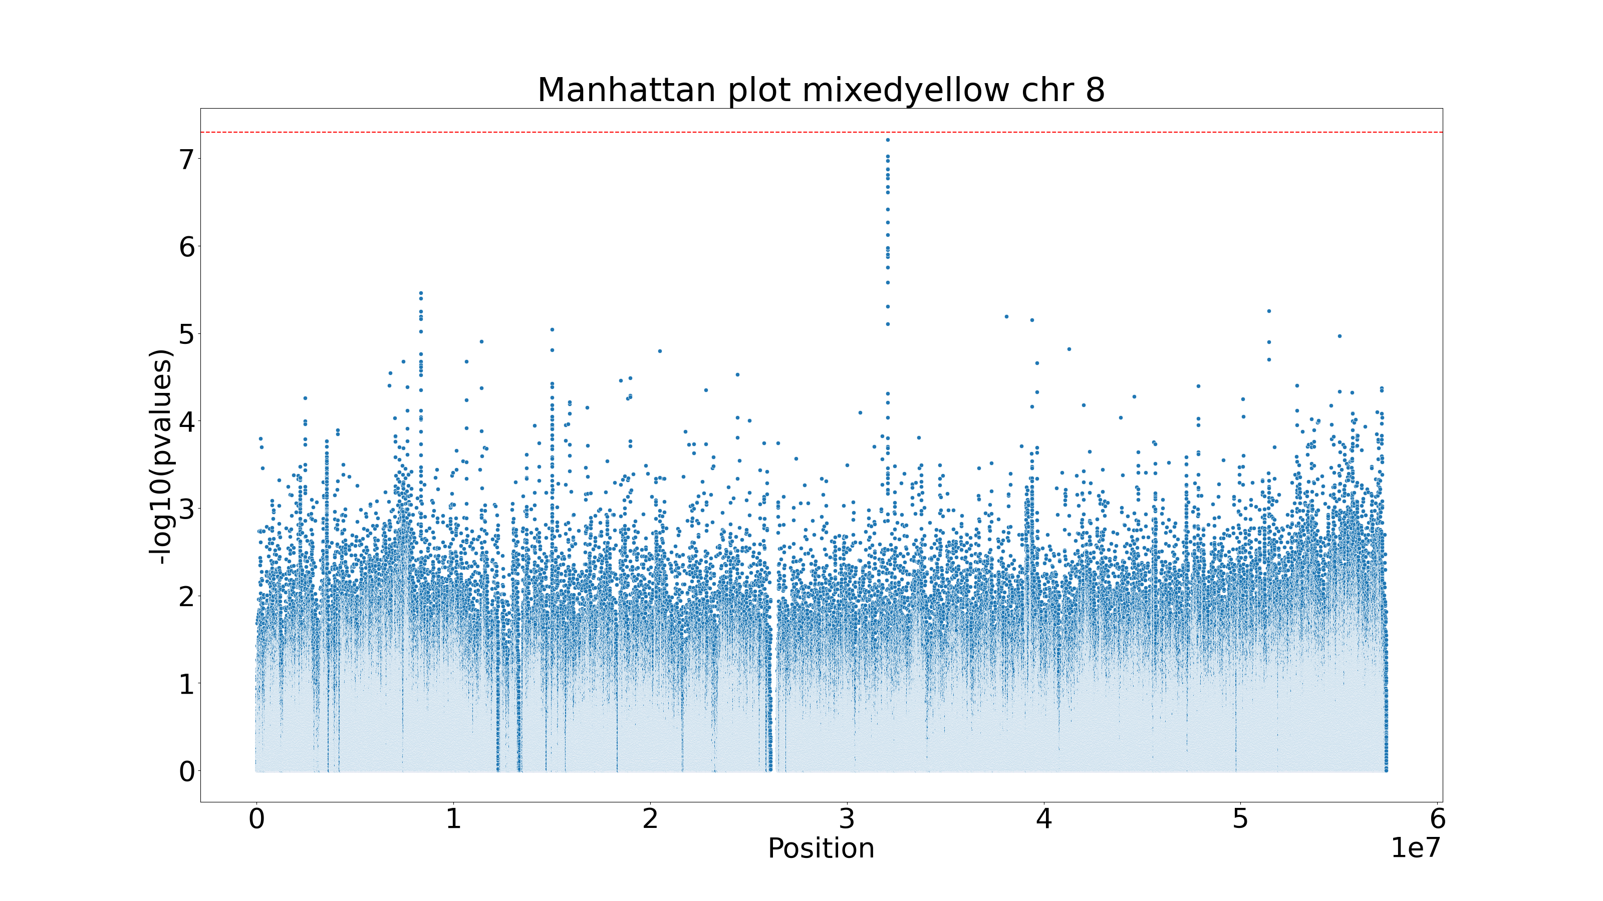
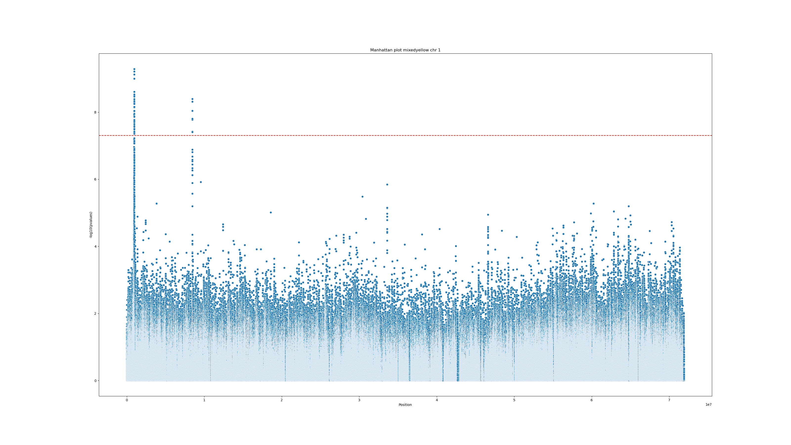

Slide 18
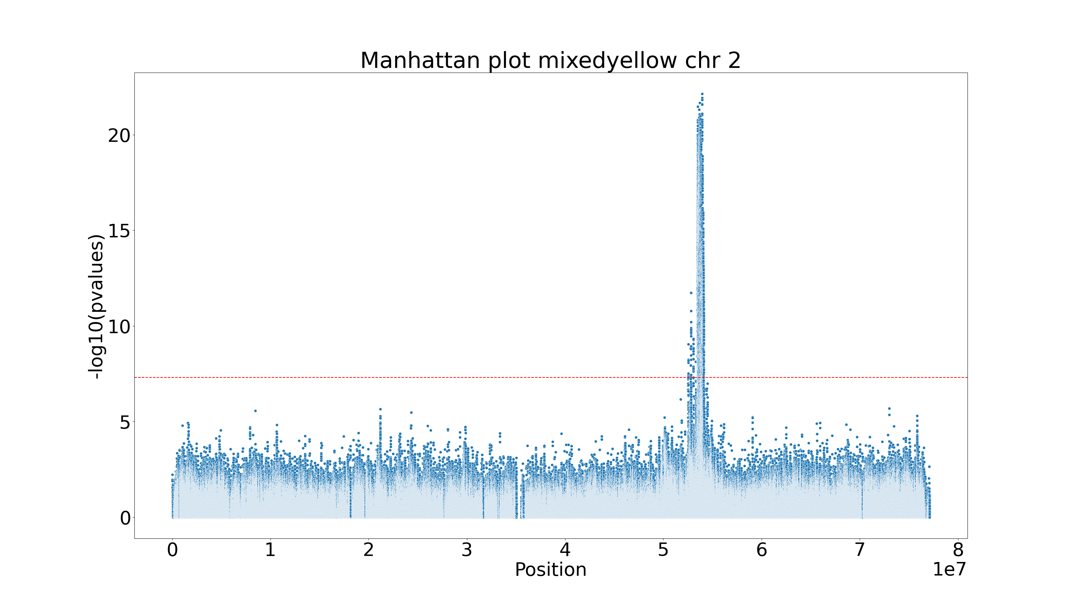

Slide 19
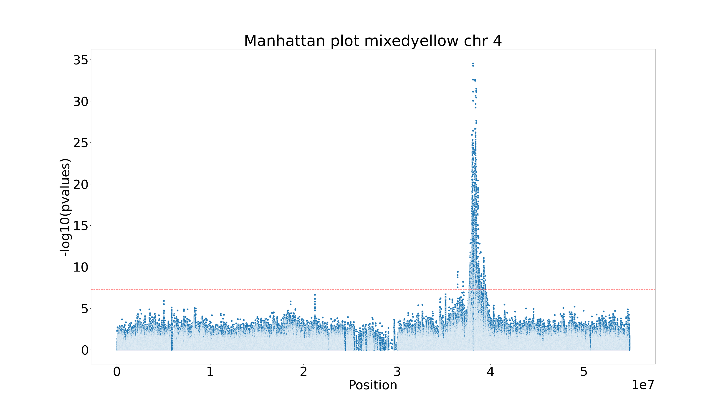

Slide 20
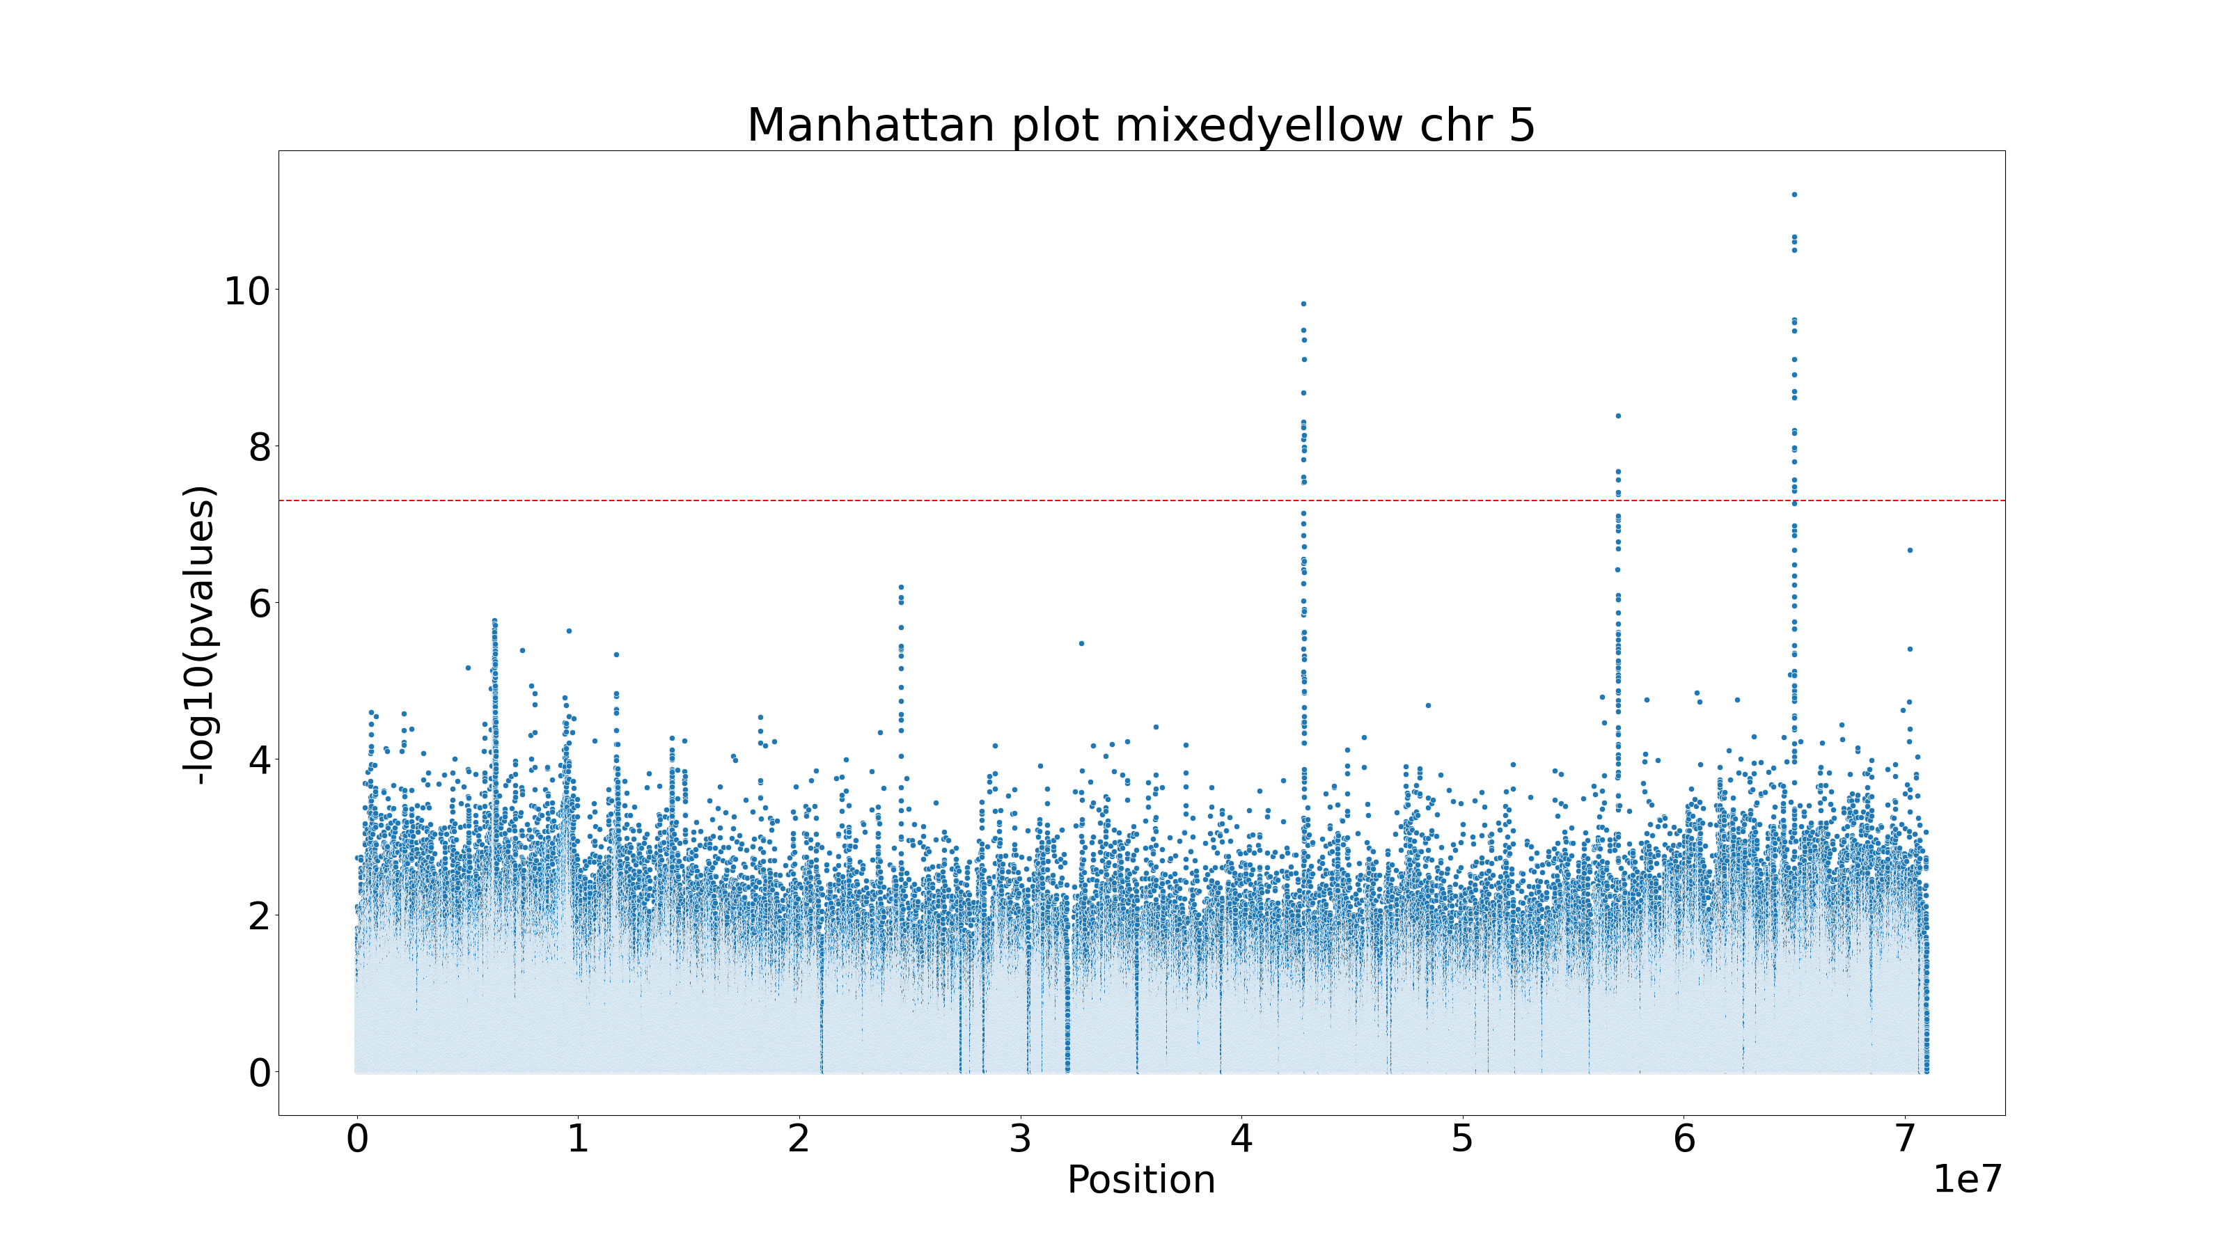

Slide 21
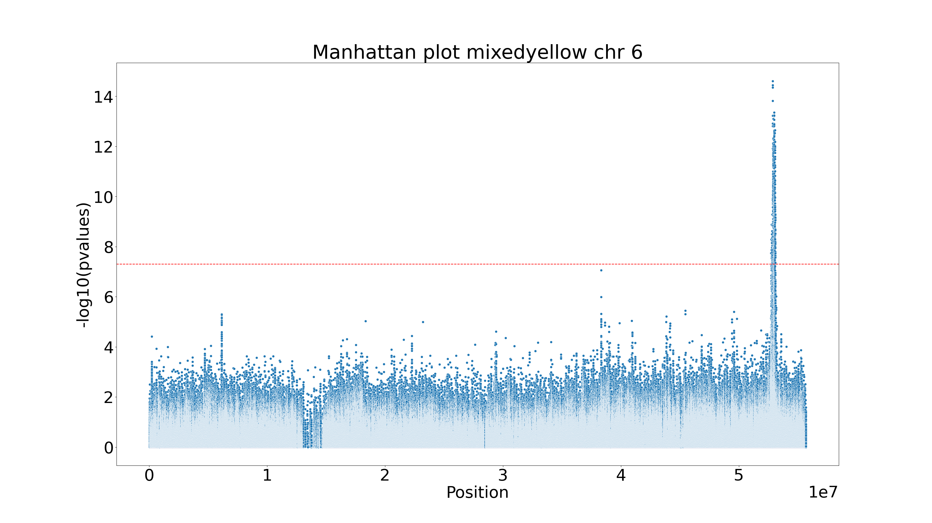

Slide 22
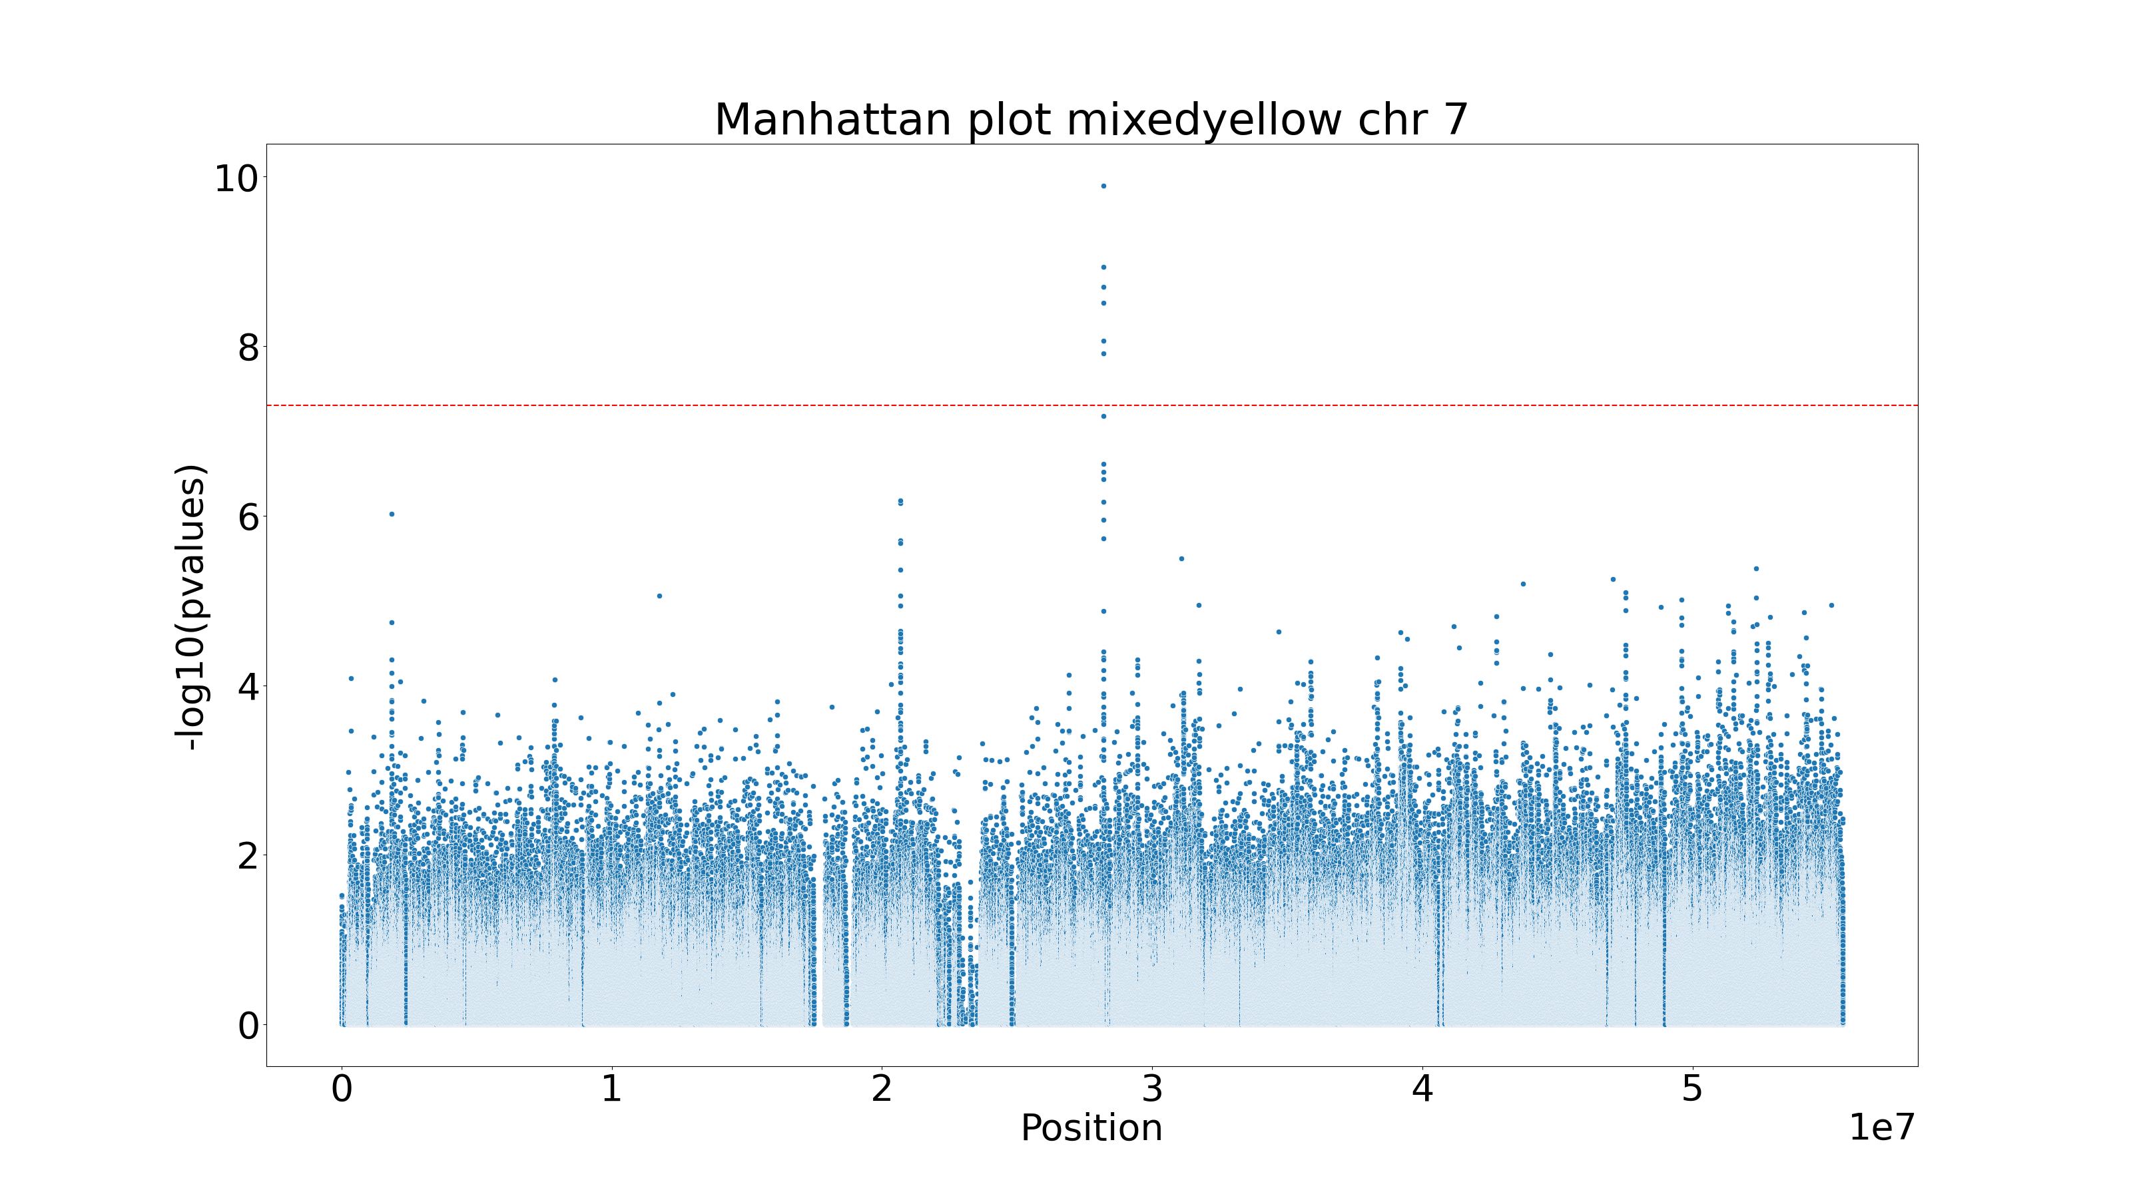

Slide 24
All individuals
red

Slide 25
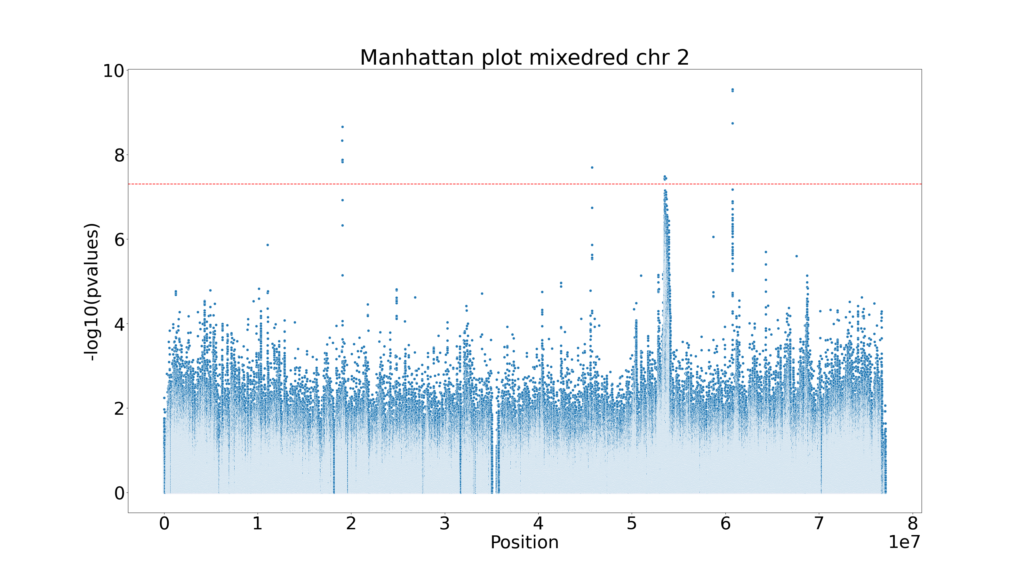

Slide 26
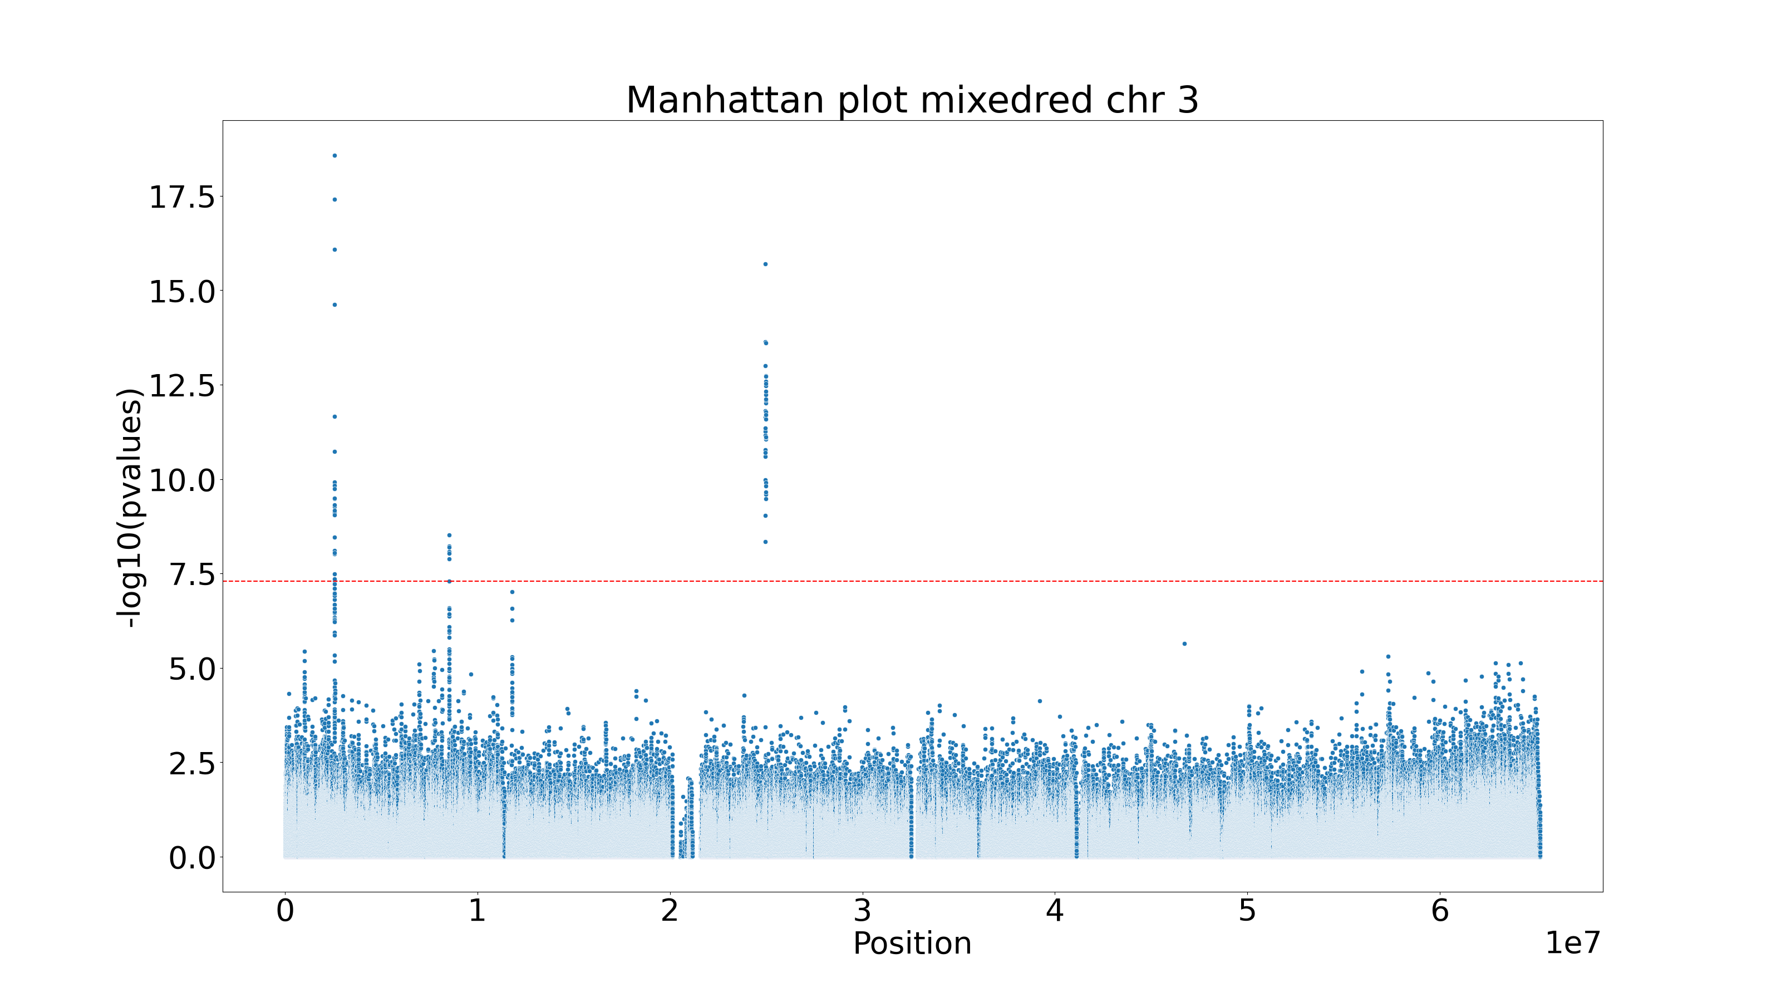

Slide 27
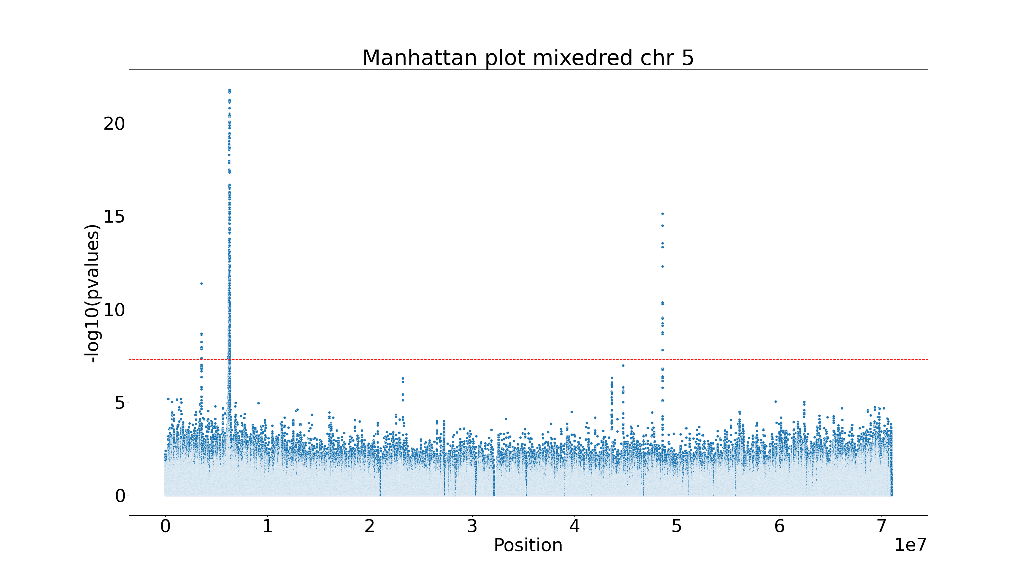

Slide 28
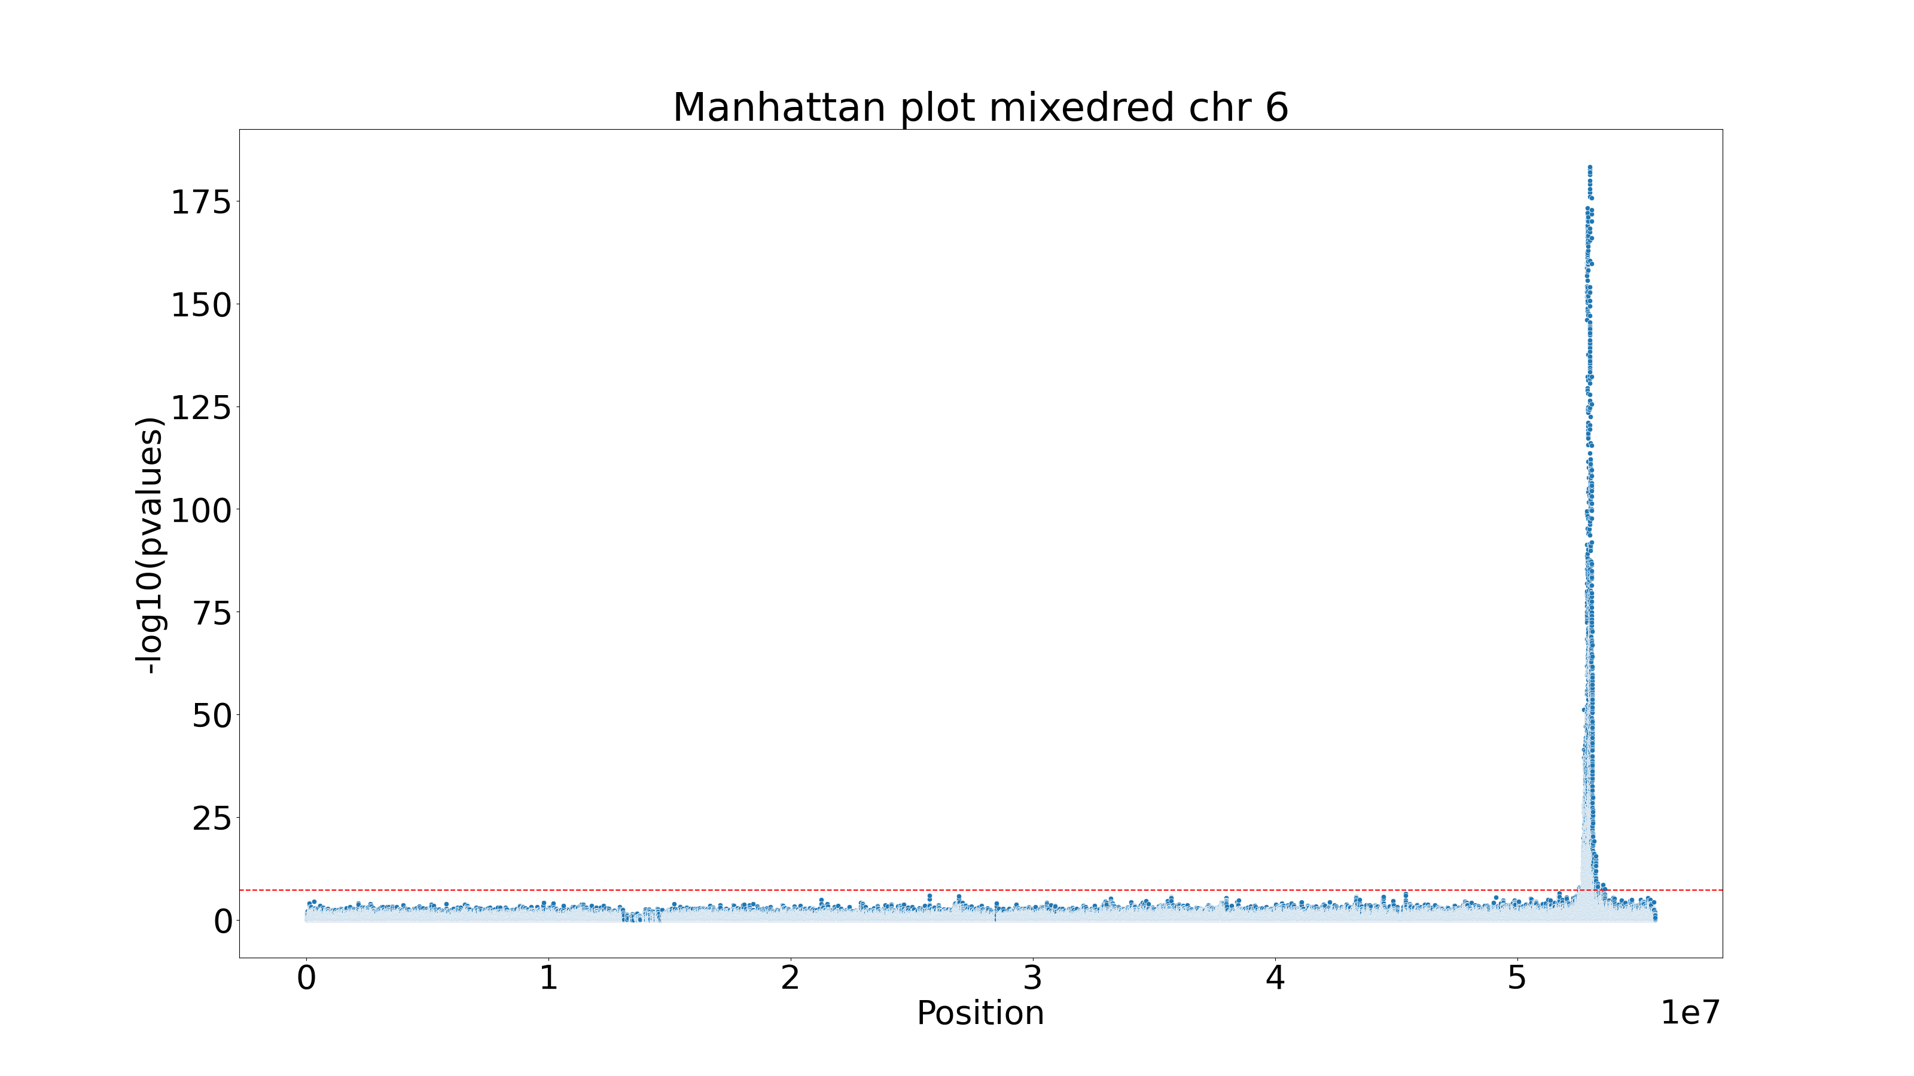

Slide 29
Applied to
All individuals
Filtered individuals: 469 individuals just in the hybrid core zone
Covariates: Phenotype yellow as covariate for red and red as covariate for yellow
Why filtering just the hybrid zone?
Outside of the hybrid zone, most individuals either have high red, low yellow and low venation or high yellow, low red, high venation.
There is an association between the traits, which means that a variant that causes red will also be statistically associated with yellow.

Slide 30
Filtering hybrid
Venation

Slide 31
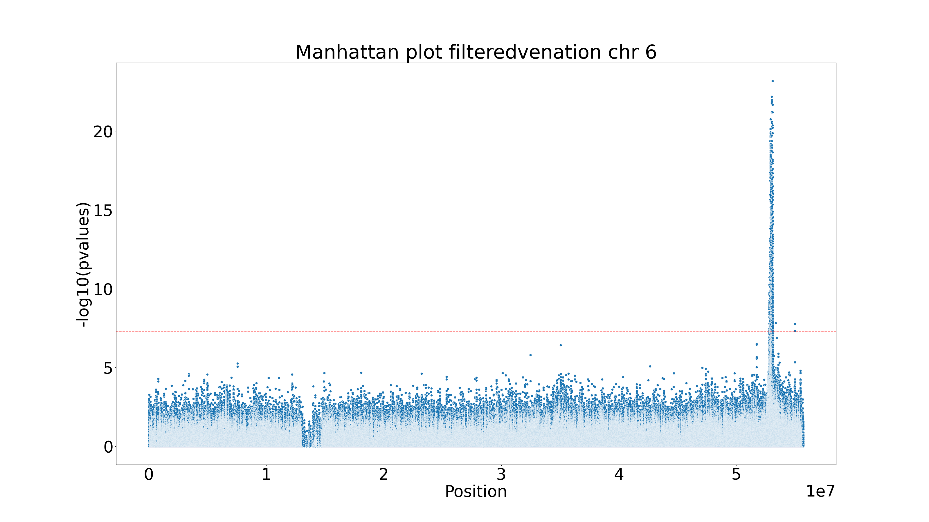

Slide 32
Filtering hybrid
Yellow

Slide 33
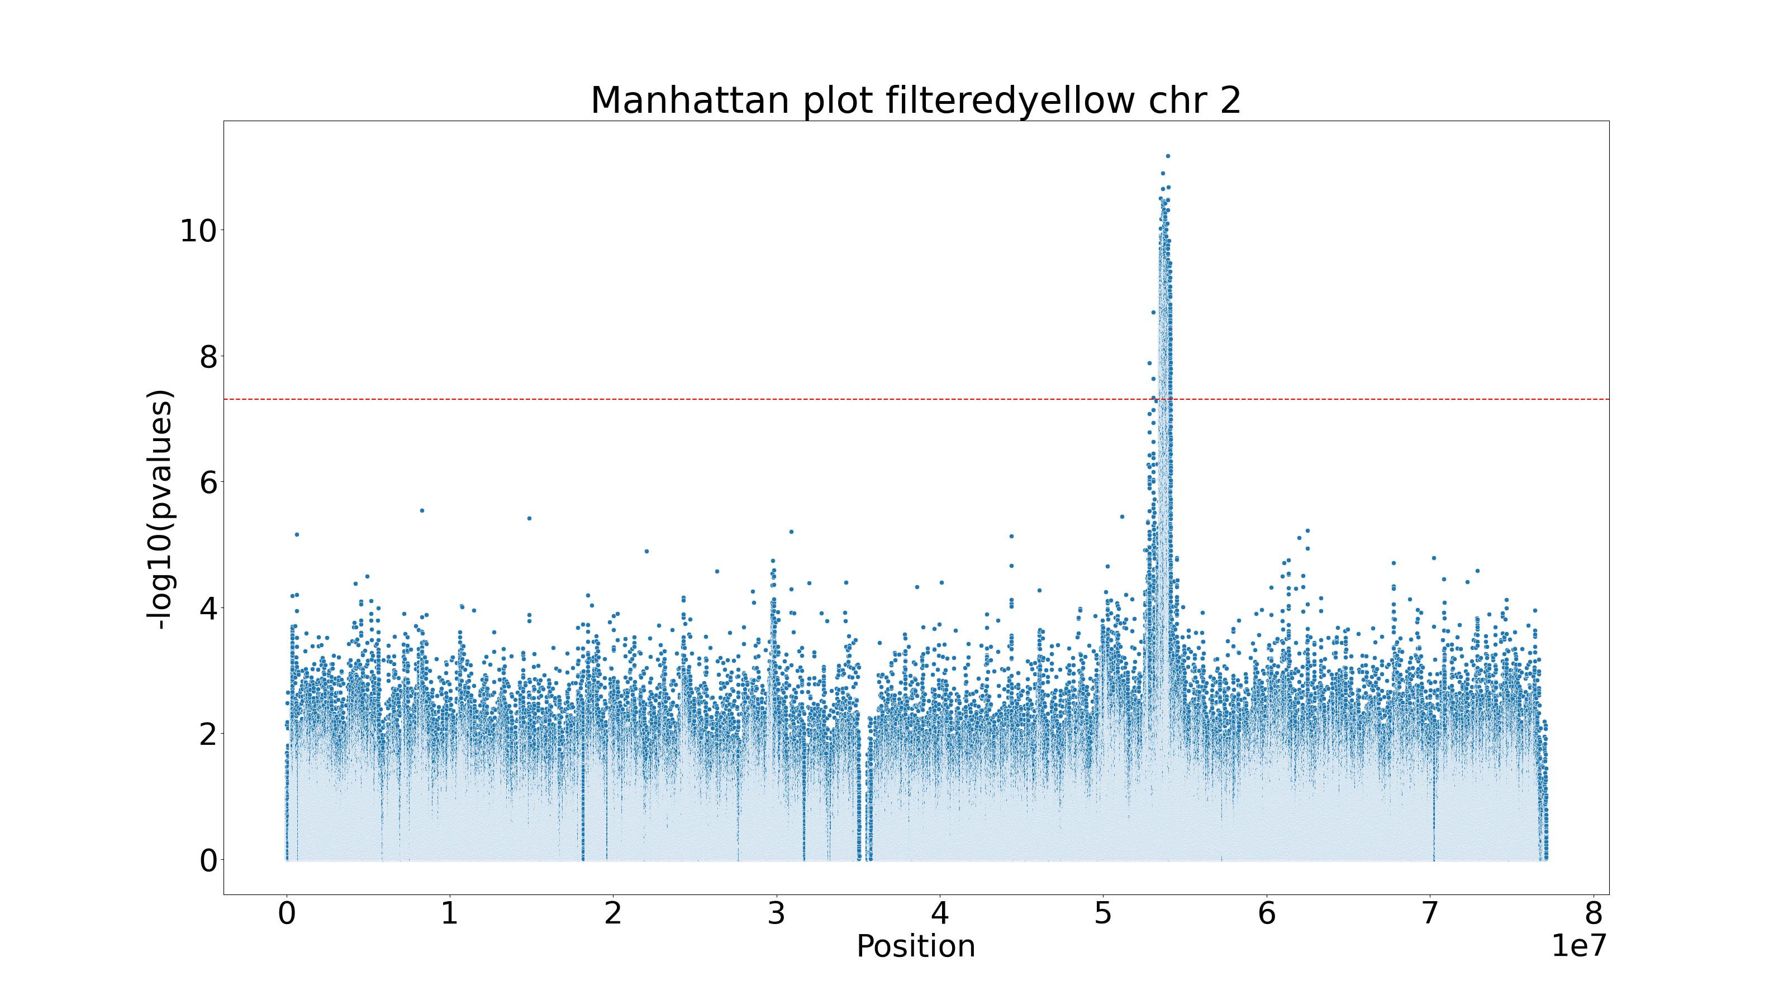

Slide 34
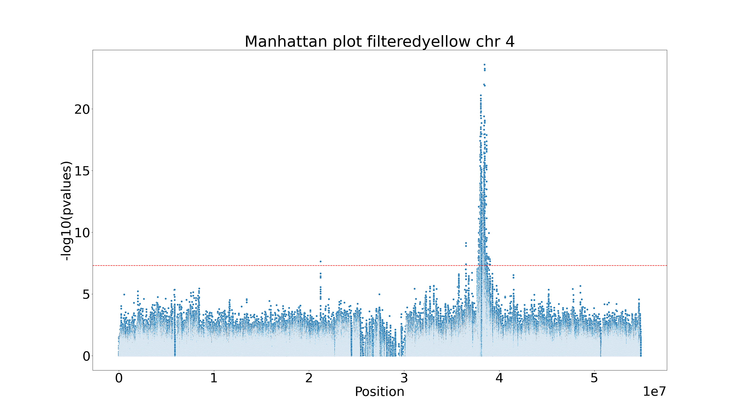

Slide 35
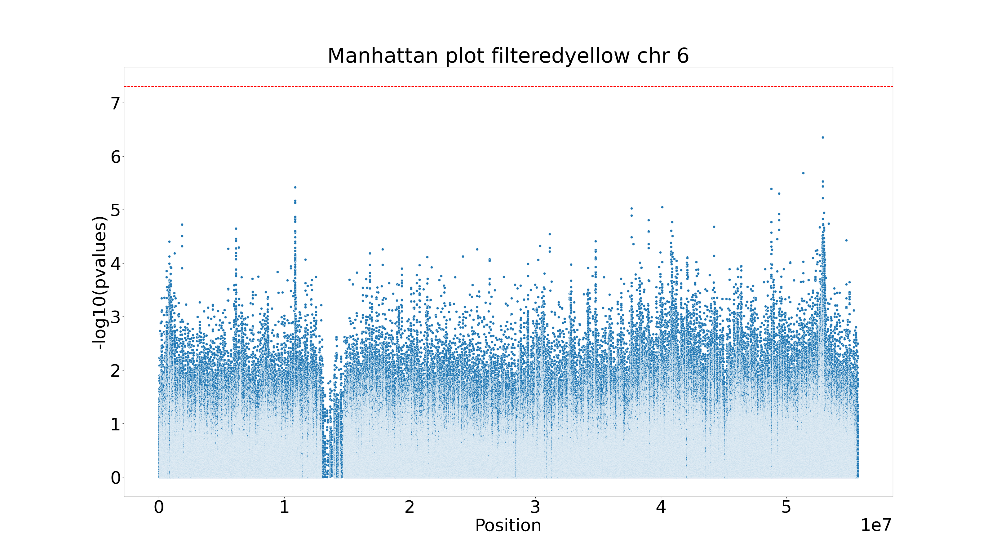

Slide 36
Filtering hybrid
RED

Slide 37
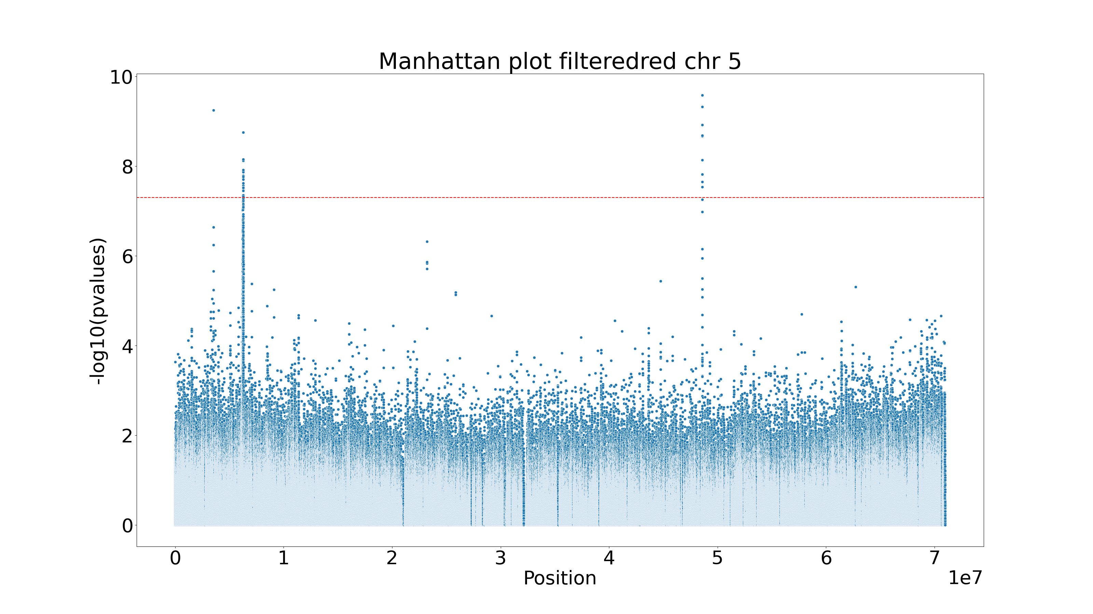

Slide 38
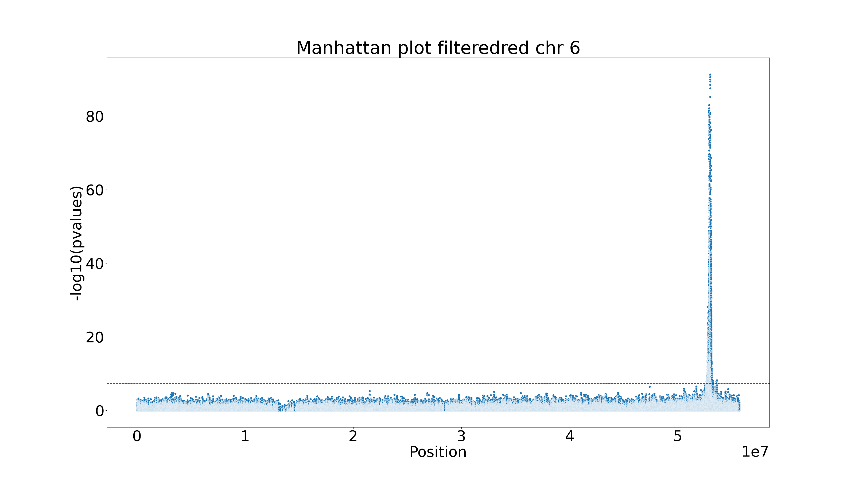

Slide 39
Filtering hybrid red covariate yellow
RED

Slide 40
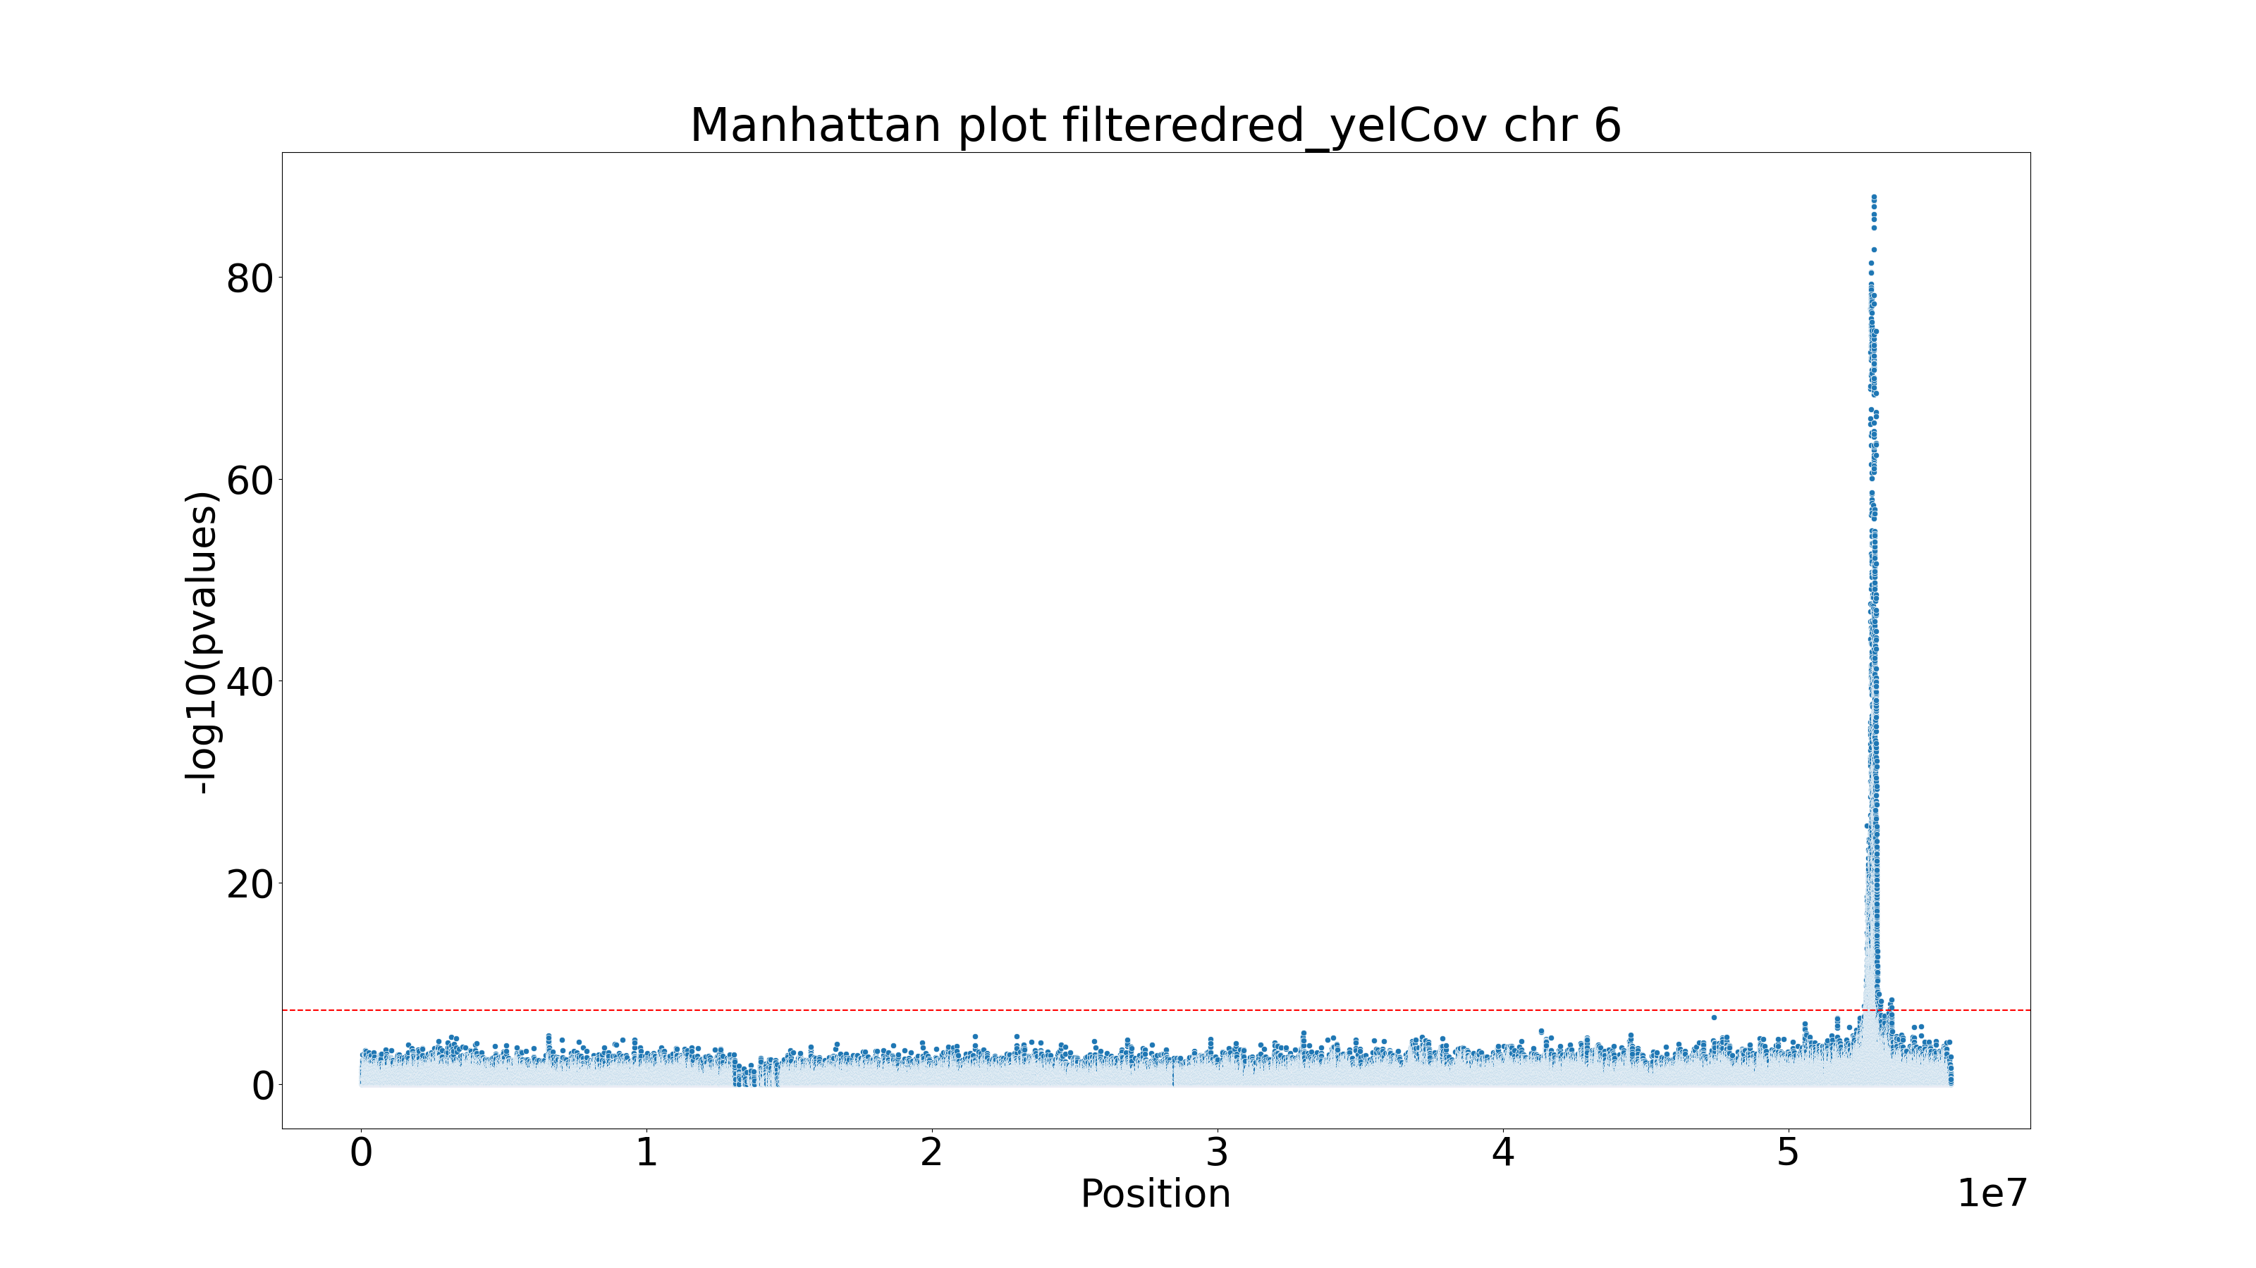

Slide 41
Filtering hybrid Yellow covariate red
yellow

Slide 42
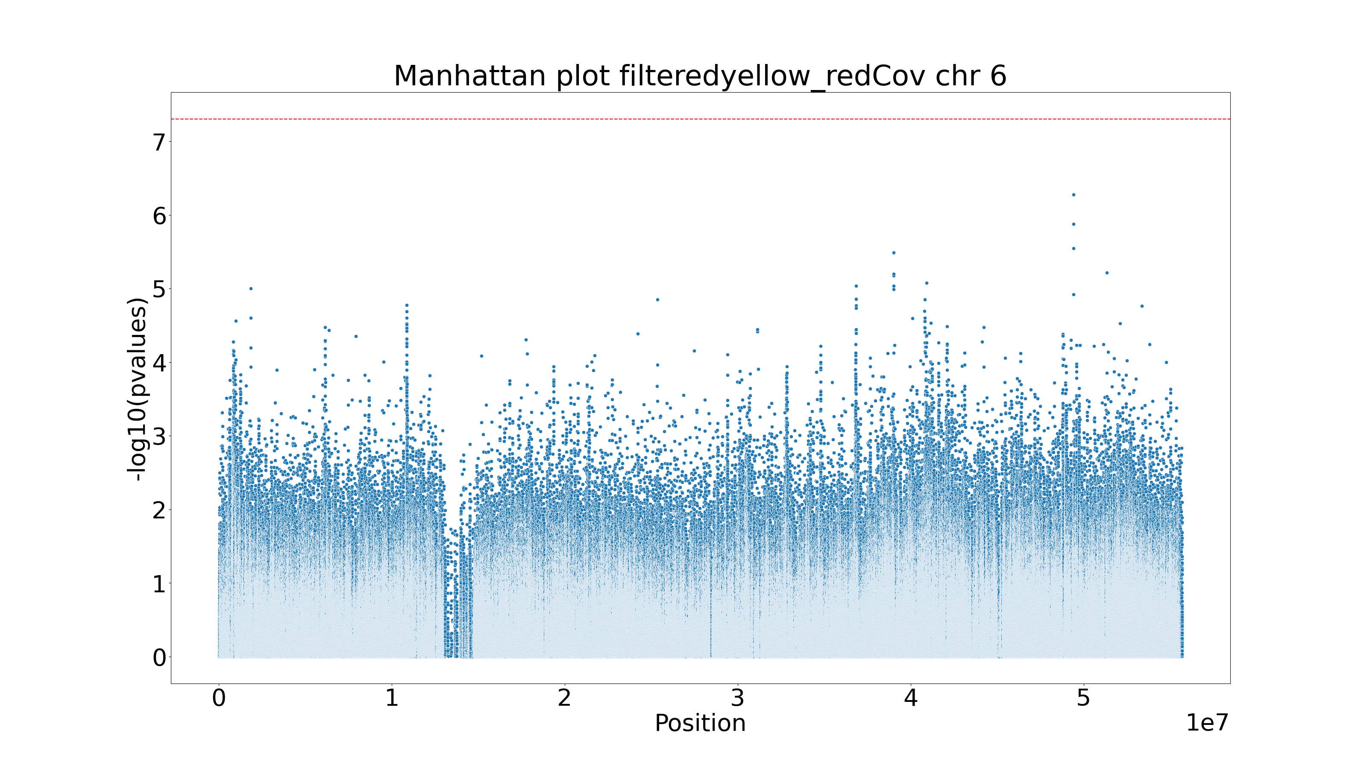

Slide 43
Conclusions
When performing a GWAS one has to be careful with associations between phenotypes in the data
Further analysis of the data and replications would be useful to detect zones of interest
Annotations of the regions are required

